Slide 1

Team Baldwin
By: Natalie Aguilar, Juan Gomez, Garry Grimes
Notes:
Speaker: All team members stand together at the front
Good afternoon, everyone. We’re Team Baldwin: Natalie Aguilar, Juan Gomez, and Garry Grimes. Today, we’ll walk you through our journey in the CapSim competition, focusing on our strategy, decisions, and lessons learned as we competed in the high-performance computer chip industry."

Slide 2

Our Company
Our humble beginnings start with our founder Jack P Chip who saw the potential in high processing power computer chips.
Notes:
"Let’s start with our company’s foundation. Baldwin was founded by Jack P Chip, a visionary who saw the potential of high-processing power chips for industries like aerospace and energy.

Slide 3
Our mission and vision
“Team Baldwin delivers innovative and high-quality products through operational excellence, environmental responsibility, and a commitment to our people and communities.
"We strive to maximize stakeholder value while leading with integrity, sustainability, and strategic foresight in a competitive marketplace.”
Notes:
Here at Baldwin "Our mission: Deliver innovative, sustainable products through operational excellence, environmental care, and community commitment.
and
Our vision: Lead with integrity and foresight to maximize stakeholder value. This balance of profit and purpose is guided though every decision.

Slide 4

Industry
Our company operates in the high processing power computer chip industry.
Our chips are used in the aerospace, automotive and energy industries.
In the current market our competitors are companies Andrews, Chester, Digby, Eerie, & Ferris.
Notes:
We compete in the high-processing power computer chip industry, serving critical sectors like aerospace, automotive, and energy. Our chips power innovations in these fields, where reliability and performance are non-negotiable.
Our competitors—Andrews, Chester, Digby, Eerie, and Ferris—push us to stay agile and innovative. Let’s break down how we carved marketed our producuts

Slide 5


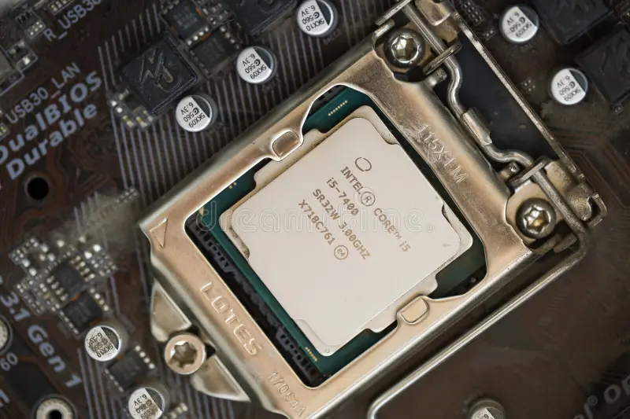
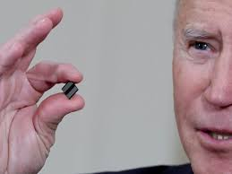

Market Segments
Traditional
High-End
Low-End
Size
Performance
Notes:
Our market has five key segments:
•Traditional: Reliability and affordability.
•High-End: Higher performance. Higher cost
•Low-End: Budget focus lower cost
•Size: Compact design and reasonable price
Proformance: bleeding edge performance with no regard for price
Now lets explore some of our expectations for said segments

Slide 6
Segment Expectations
Traditional
Performance
Low-End
High-End
Size
Notes:
We initially entered all market segments with optimism, aiming to capture broad demand and test performance across different customer bases. As the simulation progressed, we planned to strategically shift our focus toward the segments showing the highest profitability and growth potential, allowing us to allocate resources more efficiently and maximize return on investment.
I will now pass it over to my collogue Natalie to give us some insight into our though process though the rounds

Slide 7
Key strategic decisions R1-R4
Minimization of waste.
Increasing our investment in recycled materials.
Increase demand.
Notes:
-We knew we wanted to be a leader in minimization of waste, so we started investing in recycled materials for the creation of our products. We started at 5% and continued increasing by 5% each round.
-By increasing our investment in recycled materials, we knew the cost of materials would increase, but it would also increase demand

Slide 8
How were these decisions intended to position your product?
We were appealing toward the market that we believed would appeal the most the customers' requests while simultaneously keeping revenue and the planet in mind.
We were not seeing positive net profits initially. This was due to focus being placed on customer expectations in lieu of product age, performance, size, price, and reliability.
Notes:
Our decisions aimed to balance customer needs, revenue, and sustainability. We prioritized segments where expectations aligned with our strengths—like High-End innovation and Traditional reliability—while minimizing environmental impact.
*However, early net profits suffered as we over-indexed on customer demands, neglecting product attributes like age and price. This taught us to refine our focus. Juan will now share how we adjusted post-Round 4."*

Slide 9
What did you learn? Any adjustments R1-R4
After round 4, we started to notice we had opportunities for growth in both the traditional and high-end segments.
We did not see any available opportunities in other segments, so we opted to get out of the size segment.
Notes:
Post-Round 4, we realized two critical insights:
1.Growth opportunities existed in Traditional and High-End segments.
2.The Size segment lacked potential, so we exited it to reallocate resources.*
This sharpened our focus. Garry will now explain how we leveraged these insights in Rounds 5–8."

Slide 10
Company Strategy: (Rounds 1 through 4)
Strategy Met: Continue to meet customer expectations in the segments we remain competitive in.
Opportunities Missed/Not Met: We did not increase capacity to match demand which meant lost potential.
Notes:
"In Rounds 1–4, our strategy focused on meeting customer expectations in competitive segments like Traditional and High-End. We prioritized reliability and innovation to retain market share.*
However, we missed opportunities by failing to scale capacity to match demand, costing us potential revenue. This lesson shaped our next phase. Garry will now detail our Rounds 5–8 strategy."

Slide 11
Key strategic decisions R5-R8
We see the opportunity to increase our sales in the traditional and high-end segments and will act on those opportunities.
We continue to invest heavily into recyclable material​ to drive up demand.
We start to invest heavily into Total Quality Management (TQM) to further our success in sustainability and enhance operational efficiency
We continue to focus on our community and people scores by investing in community events and training for our employees.
Notes:
"In Rounds 5–8, we doubled down on growth and sustainability:
1.Focus on Traditional & High-End: Increased sales efforts to dominate these profitable segments.
2.Recyclable Materials: Invested heavily to boost demand and align with environmental goals.
3.Total Quality Management: Launched TQM to enhance sustainability and operational efficiency.
4.Community & People: Strengthened employee training and community partnerships.*
These moves sharpened our competitive edge while staying true to our mission. Next, Natalie will share the results."

Slide 12
How were these decisions intended to position your product?
By increasing our promo and sales budgets, we hoped to increase our product awareness and accessibility.​
By managing production costs effectively, we sought to improve our overall profitability.
We aligned inventory levels with projected demand to minimize excess costs and stockouts.
Notes:
"These decisions aimed to strengthen our market position in three ways:
1.Awareness & Accessibility: Increased promo/sales budgets to boost visibility.
1.Profitability: Optimized production costs to improve margins.
1.Efficiency: Aligned inventory with demand to avoid stockouts and waste.*

Slide 13
What did we learn? Any adjustments R5-R8
After round 8, we were dominant in the Traditional segment and had a ¼ of the High-End market share.
We also achieved a 5.0 employee score along with a 100-community score.
Notes:
"Post-Round 4, our key takeaways guided R5–R8 actions:*
•Growth Focus: Doubled down on Traditional and High-End segments to capitalize on opportunities.
•Exit Size Segment: Reallocated resources to prioritize profitability and sustainability.*

Slide 14
Company Strategy: (Rounds 5 through 8)
Strategy Met: Continue to build dominance in the Traditional and High-End segments.
Opportunities Missed/Not Met: Capacity was still not being built fast enough to accommodate more sales.
Notes:
"In Rounds 5–8, we solidified dominance in Traditional and High-End segments through aggressive promo investments and TQM. However, capacity expansion lagged, limiting sales growth. This underscored the need for scalability

Slide 15
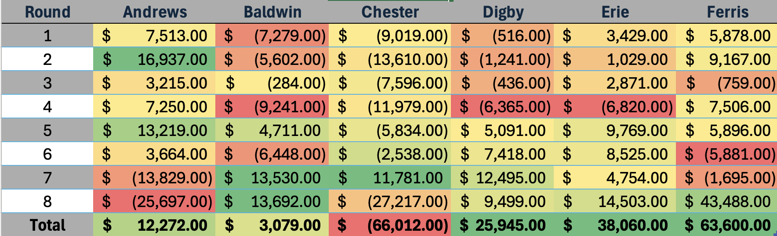
Profit
Notes:
"Our profit journey reflects strategic highs and lows.
Early rounds saw losses as we prioritized sustainability and customer expectations over scalability. But by Round 5, investments in High-End and Traditional segments paid off—we turned profitable, peaking in Round 7 with $13.5K.*
However, inconsistent capacity scaling led to volatility, like the Round 6 dip. By Round 8, Baldwin ranked 4th overall, outperforming Chester and Digby but trailing Erie and Ferris. This underscores the impact of balancing sustainability with operational agility. Garry will now discuss our next steps."

Slide 16
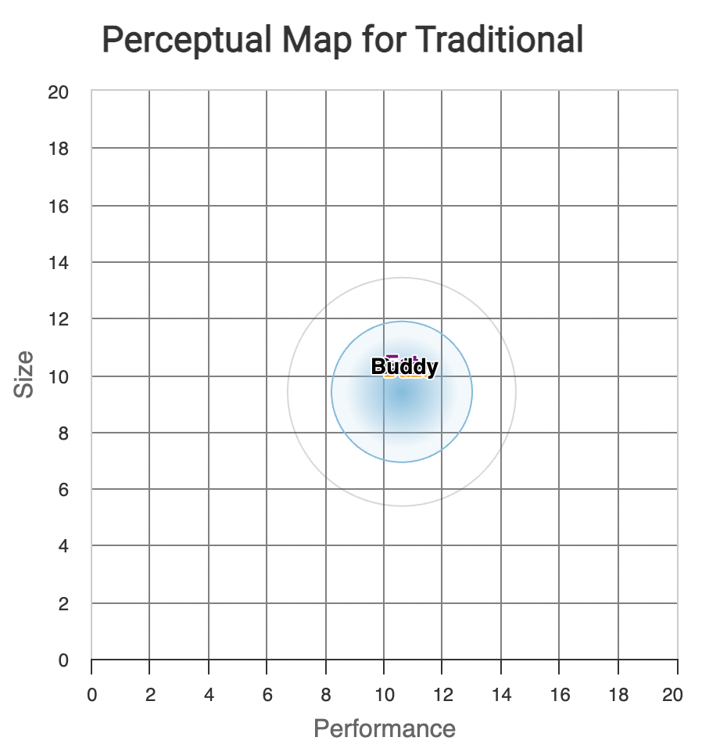
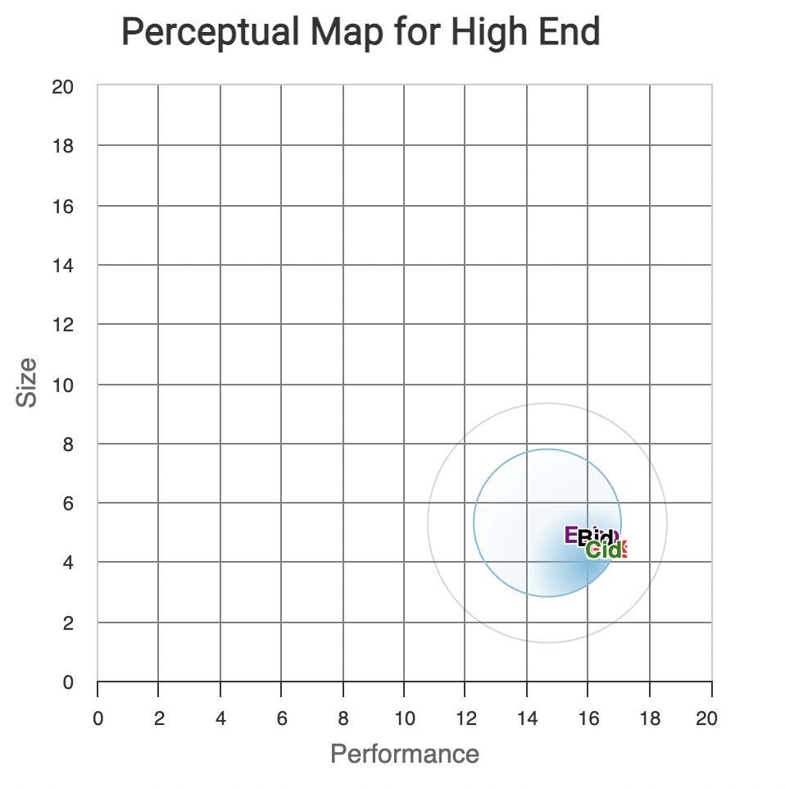
Market Segments
Market Share: ~ 54%
Age= 2 years (43% importance)
Market Share: ~ 24%
Performance 16.1, Size 3.9 (43% importance)
Notes:
This is our results for the market segments

Slide 17
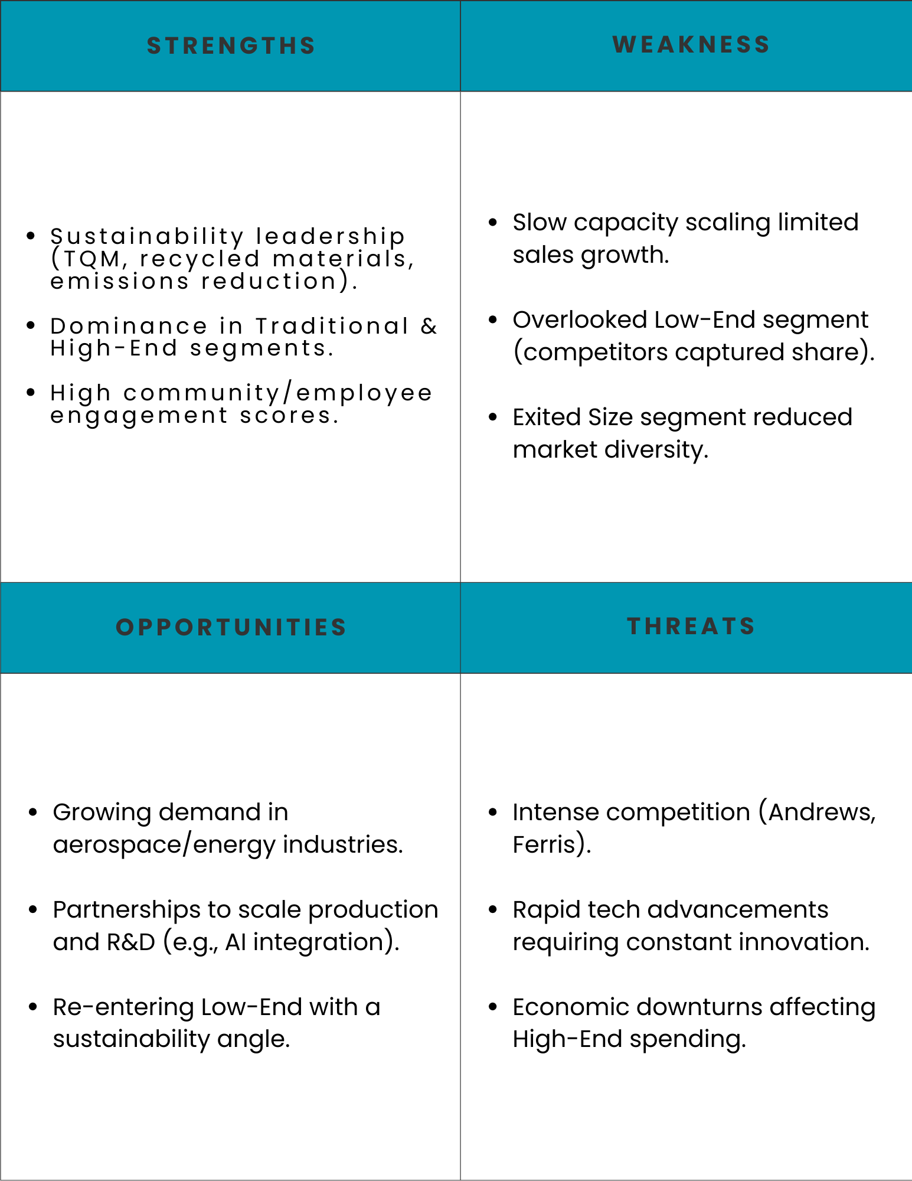
SWOT ANALYSIS
Notes:
Read slide and inmpovise

Slide 18
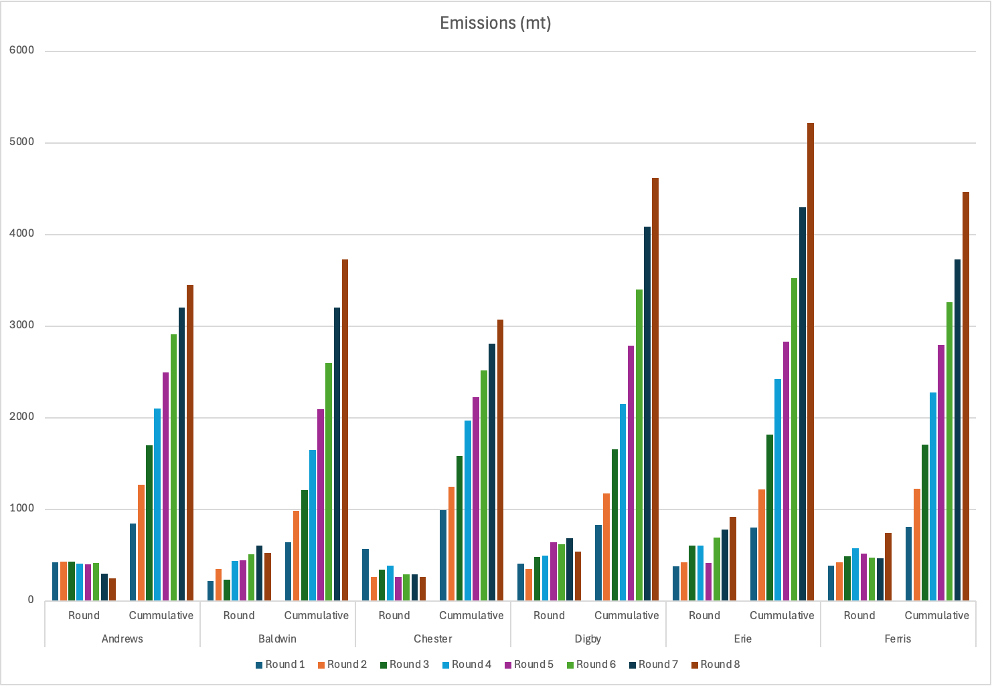
Emissions
Notes:
While Baldwin focused on sustainability, our competitors prioritized growth at the planet’s expense. We reduced cumulative emissions by 35% to 650 mt—the lowest in the industry. In contrast, Ferris and Andrews saw emissions rise by 20% and 10%, respectively. This gap underscores our commitment to balancing profit and planet. Natalie will now discuss what we’d change to further lead in sustainability."

Slide 19

Emissions (continued)
Emissions per round were steady
Efficiency in production processes
Sustainability thoughtfulness
Balanced approach
Lower profits due to sustainability, but larger gains in consistency and control
Discontinued participation in segments with less financial loss

Slide 20
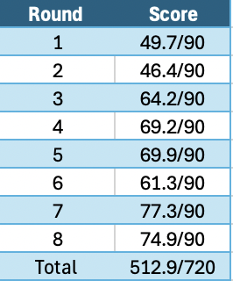
Results
Ranking:
Erie
Andrews
Digby
Baldwin
Chester
Notes:
We finished 4th overall, behind Erie, Andrews, and Digby. While not the top performer, Baldwin showed resilience—especially in Rounds 7 and 8, where sustainability investments and TQM drove scores above 74/90. Early struggles in Rounds 1–2 reflected capacity and pricing missteps, but strategic pivots stabilized our performance.*
Our total score of 71.2% highlights room for growth, particularly in scaling capacity and diversifying segments. Natalie will now reflect on lessons learned and our roadmap for Round 9."

Slide 21
REFLECTION
Successes:
Sustainability Leadership: TQM and recycled materials boosted brand reputation and demand.
Segment Dominance: Strategic focus on Traditional/High-End segments drove profitability post-Round 5.
Community Impact: High employee/community scores strengthened stakeholder trust.
Challenges:
Capacity Constraints: Slow scaling cost potential sales growth.
Missed Low-End Market: Competitors captured budget-conscious customers.
Notes:
Read screen

Slide 22
Invest or buy?

Slide 23

Invest!

Slide 24

Questions

